Slide 1
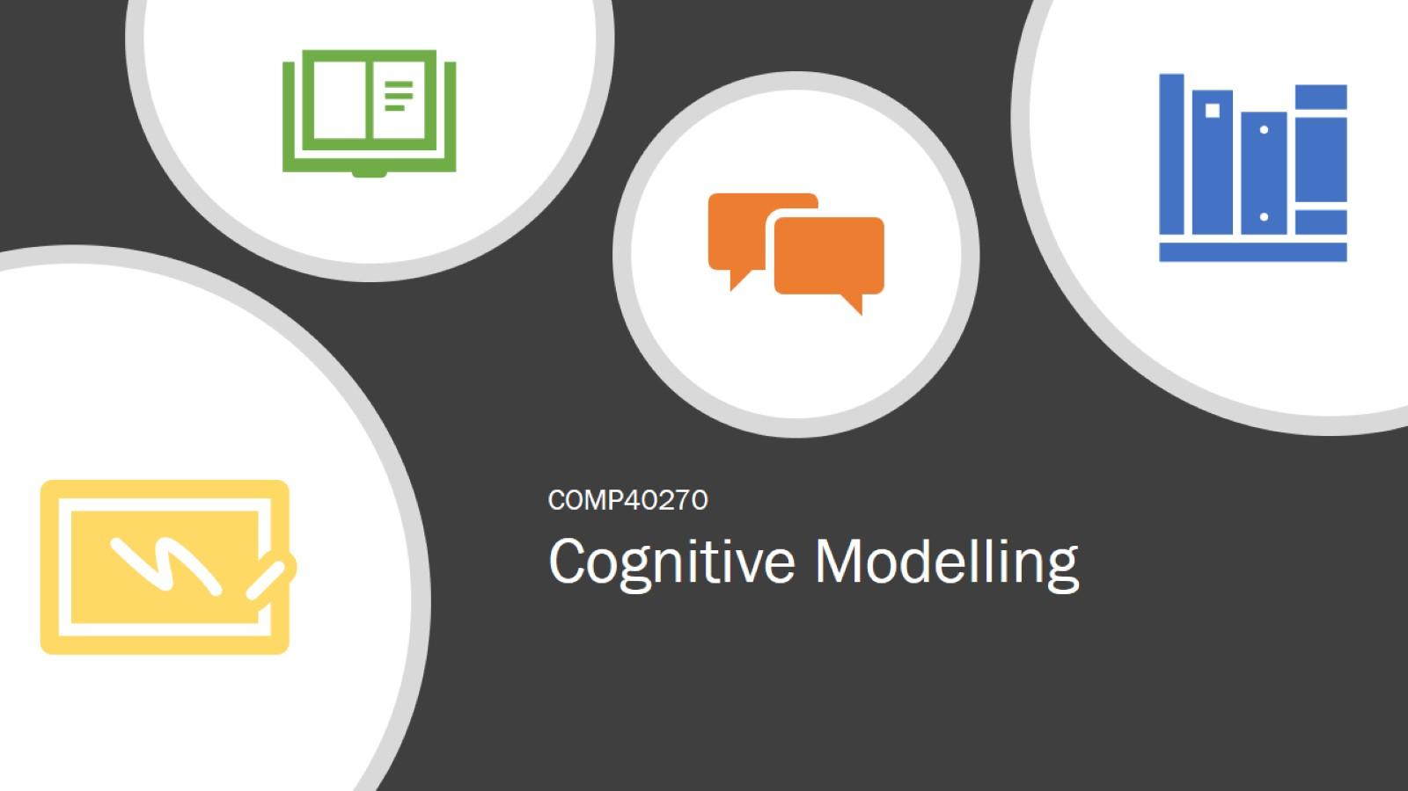
Cognitive Modelling

Slide 2

Decisions I made on my journey

Slide 3
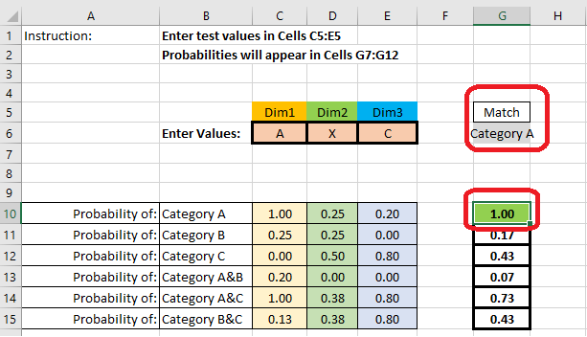
Decision # 1
Decision # 1
“Even though I know…”
I still scan for exact matches despite being told that this will not be the case.
I incorporated a check to compare a concatenation of the test data with a concatenation of the sampla data for an exact match.

Slide 4
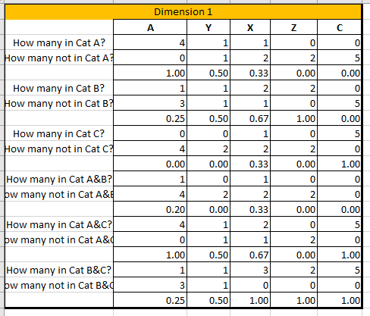
Decision # 1
Decision # 2
General Approach – Bayesian
I looked at the frequency of each attribute per dimension to test the likelihood of the attribute being a member of each category.
The more frequently it occurs in group and the less frequently it occurs out of group then the higher the probability of it being a member.
Each attribute per dimension has a weight per category.

Slide 5
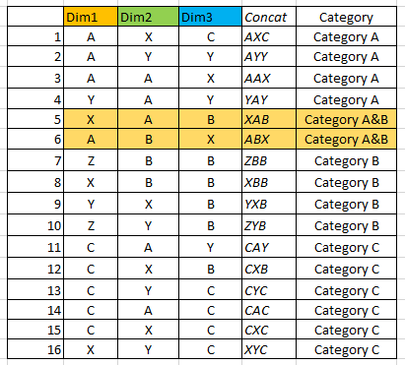
Decision # 1
Decision # 3
How to deal with A&B
Because data was provided for the specific conjunctive category A&B I considered that to be a distinct category in it’s own right.
However because no such data was provided for categories A&C and B&C I leveraged the component categories in each case to create a conjunction.

Slide 6
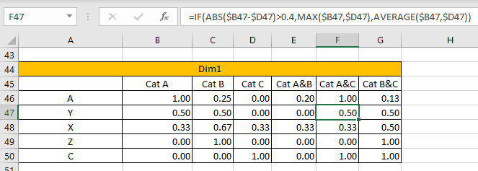
Decision # 1
Decision # 4
Categories A&C, B&C
If the difference in probabilities between the constituent categories exceeds a certain threshold (0.4) then the higher (MAX) of the 2 probabilities is assumed
– reference to Conjunction Fallacy (Tversky & Kahneman, 1983).
If threshold is not reached the average is taken rather than minimum as I believe there remains a confirmation bias or a need to believe the data fits.

Slide 7
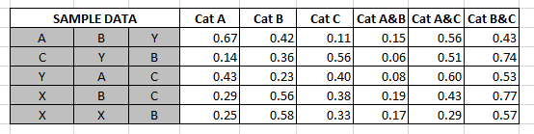
Results – Probabilities for Sample Data *
* I don’t know how this correlates to the sample responses

Slide 8
Challenges
I initially struggled with the reductionist nature of Cognitive Modelling – however my attitude changed.
I found it very difficult to accept that there was no right answer when the “results” were already available to me.
The model represents a rational approach but there are quite often irrational responses – informed by bounded rationality – it’s not worth the effort for some people to really analyse the data and they just guess.
I did not include concept of noise or distortion (e.g. context, experience, personality) even though I believe it has a role to play. I could not see how to apply to represent actual individual behaviour, it may be more appropriate at an aggregate level.

